Slide 1










Negotiation type license in network zone and POLs in member institutions
Yoel Kortick. Senior Librarian
http://www.julac.org/

Slide 2


Introduction
Adding the Negotiation type license in Network Zone
Attributing inventory to the Negotiation type license
License members and negotiation details
Creating the order in the member institution
https://slidemodel.com/templates/animated-rainbow-business-powerpoint-template/
http://image.shutterstock.com/z/stock-photo-business-hand-writing-blank-agenda-list-130255148.jpg

Slide 3
Introduction
This feature deals with Acquisition Networks that manage licenses of type Negotiation
With this feature it is possible to have a situation in which the content negotiated for each member per license
  Is the same
  Is not the same
In other words: each member may have different content for the same license.
Even when the content is the same for different members, it may have a different price, start date and end date.
URM-60366

Slide 4
Introduction
In other words: it is possible to manage a “complex deal” in which the content of the license is different for each member
The central / head office negotiates a deal with a vendor and can then use a license of type ‘negotiation’ to indicate for each member the relevant content that was negotiated for each member.
In this way the central / head office does not have to maintain a separate license for each institution.
URM-60366

Slide 5
Introduction
Adding the Negotiation type license in Network Zone
Attributing inventory to the Negotiation type license
License members and negotiation details
Creating the order in the member institution
https://slidemodel.com/templates/animated-rainbow-business-powerpoint-template/
http://image.shutterstock.com/z/stock-photo-business-hand-writing-blank-agenda-list-130255148.jpg

Slide 6

Adding the Negotiation type license in Network Zone
From within the network zone add a license using menu ‘Acquisitions > Acquisitions Infrastructure > Licenses > Add’
Choose type “Negotiation”
On the next screen we will see license “Kowloon Resources Ltd.” with code “KRL”
It is type “Negotiation” because when adding it we chose “Negotiation”

Slide 7
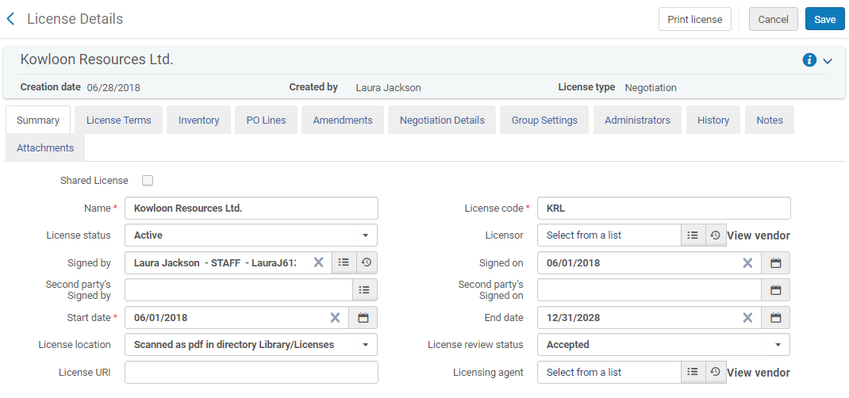
Adding the Negotiation type license in Network Zone

Slide 8
Adding the Negotiation type license in Network Zone
Note on the previous slide that the checkbox “Shared License” is not checked.
In this scenario we want to have a license which is not shared with the members and is entirely managed in the network. Therefore we did not check “Shared License”
Selecting “Shared License” would push the license to all member institutions, enabling each one to purchase resources and attach them to their local copy of the license.
The Shared License would be pushed to the members the next time that the “Distribute Network Acquisition Changes to Members” job runs

Slide 9
Introduction
Adding the Negotiation type license in Network Zone
Attributing inventory to the Negotiation type license
License members and negotiation details
Creating the order in the member institution
https://slidemodel.com/templates/animated-rainbow-business-powerpoint-template/
http://image.shutterstock.com/z/stock-photo-business-hand-writing-blank-agenda-list-130255148.jpg

Slide 10
Attributing inventory to the Negotiation type license
Now we will associate relevant resources in the network zone with the network zone negotiation license “Kowloon Resources Ltd.”.
In the network institution the following four resources all have license “Kowloon Resources Ltd.”.
Local Electronic Collection: Project Gutenberg ebooks related to Hong Kong
CZ Electronic Collection: Hong Kong Journals Online
Local Portfolio: From Hong-Kong to the Himalayas: or, Three thousand miles through India
CZ Portfolio: Girl from Hong Kong: a novel

Slide 11
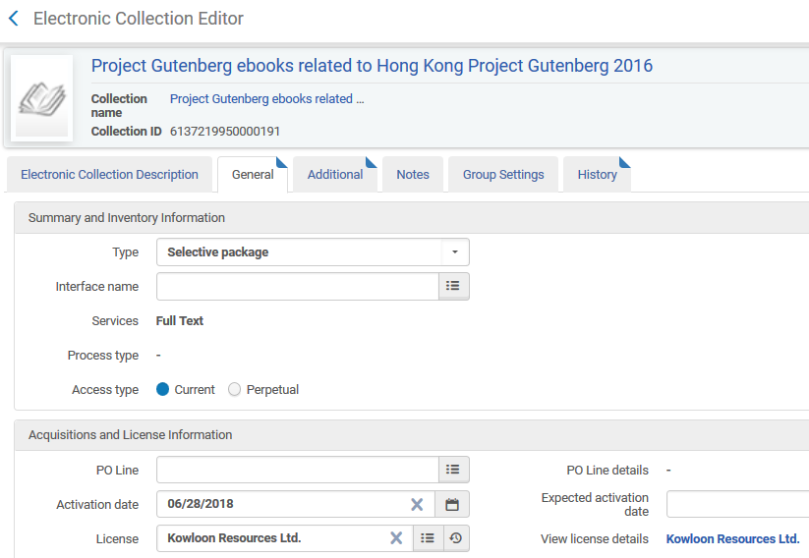
Attributing inventory to the Negotiation type license
The local electronic collection “Project Gutenberg ebooks related to Hong Kong” in the network zone is associated with network zone negotiation license “Kowloon Resources Ltd.”.

Slide 12
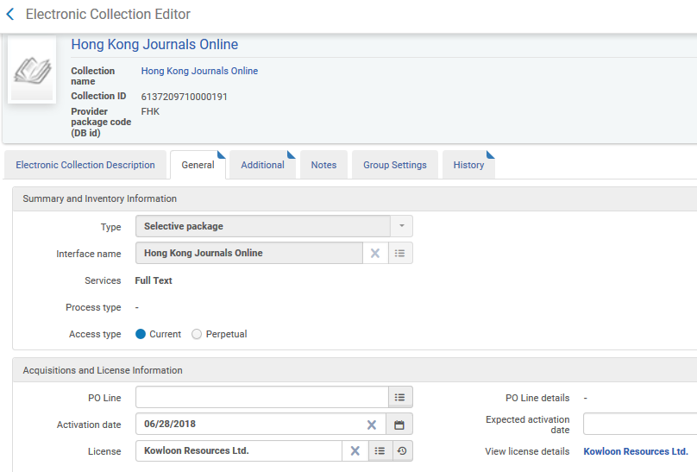
Attributing inventory to the Negotiation type license
The electronic collection activated from CZ “Hong Kong Journals Online” in the network zone is associated with network zone negotiation license “Kowloon Resources Ltd.”.

Slide 13
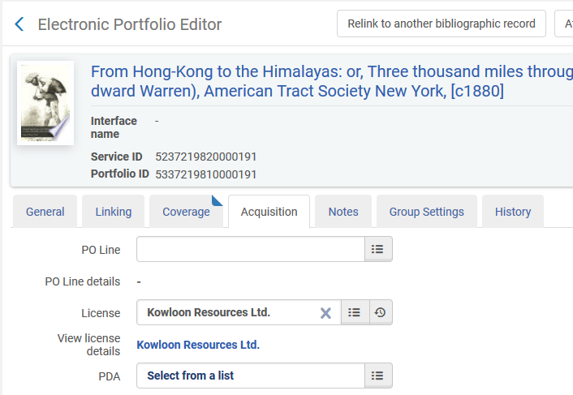
Attributing inventory to the Negotiation type license
The local portfolio “From Hong-Kong to the Himalayas: or, Three thousand miles through India” is associated with network zone negotiation license “Kowloon Resources Ltd.”.

Slide 14
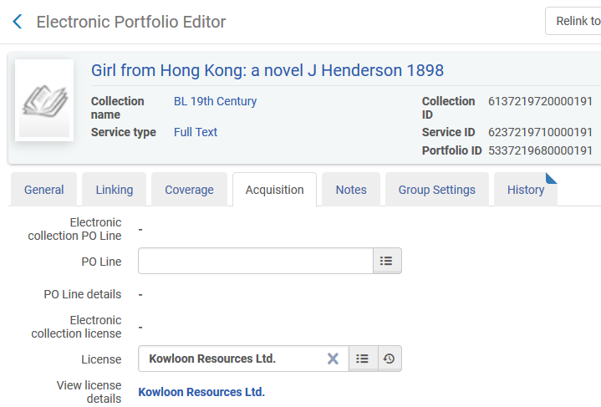
Attributing inventory to the Negotiation type license
The CZ portfolio “Girl from Hong Kong: a novel” is associated with network zone negotiation license “Kowloon Resources Ltd.”.

Slide 15
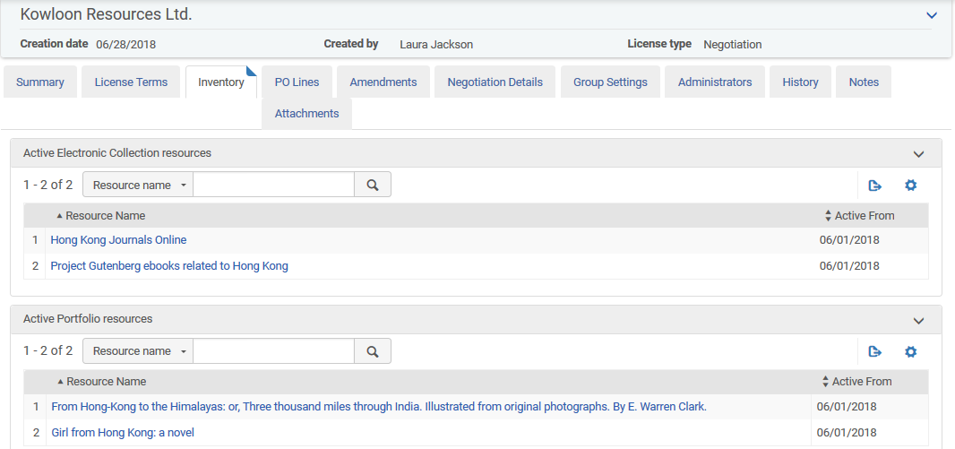
Attributing inventory to the Negotiation type license
All four resources appear in the “Inventory” tab of the license.

Slide 16
Introduction
Adding the Negotiation type license in Network Zone
Attributing inventory to the Negotiation type license
License members and negotiation details
Creating the order in the member institution
https://slidemodel.com/templates/animated-rainbow-business-powerpoint-template/
http://image.shutterstock.com/z/stock-photo-business-hand-writing-blank-agenda-list-130255148.jpg

Slide 17
License members and negotiation details
But … not every member of the license might have access via the license to all four resources.
Further, even if multiple members do have access to the same resource it might be under differing terms.
The actual license will be as follows
Open University pays 100.00 USD for a period of 01/01/2018 to 12/31/2018 for all four resources (both collections and both portfolios)
Alma University pays 75.00 USD for a period of 01/01/2018 to 12/31/2018 for both collections (Alma University cannot purchase the two portfolios using this license because they are not in the negotiation details for this member institution)

Slide 18
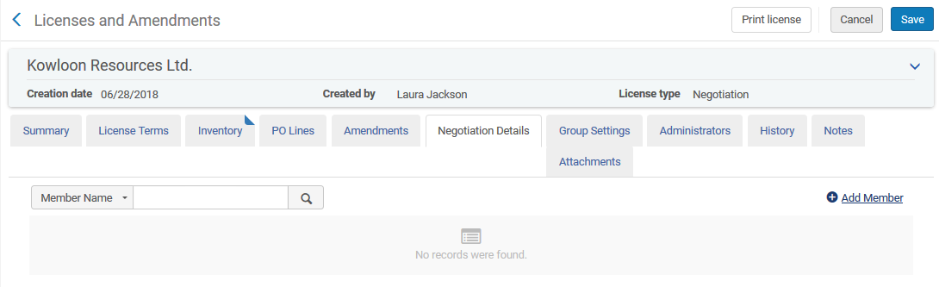
License members and negotiation details
It is therefore possible to edit each member and then attribute only the relevant resources (inventory).
First we will add member “Open University”.

Slide 19
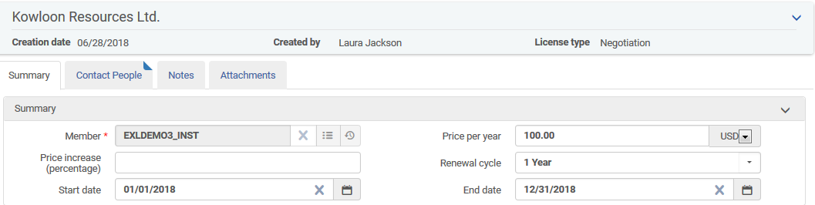
License members and negotiation details
Here we have added Open University and stated that it will cost 100 USD

Slide 20
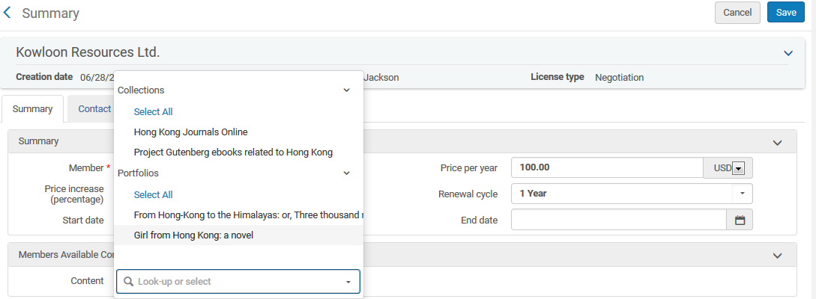
License members and negotiation details
Now for this specific member the staff user can choose which content is relevant.
We will select all four resources.

Slide 21
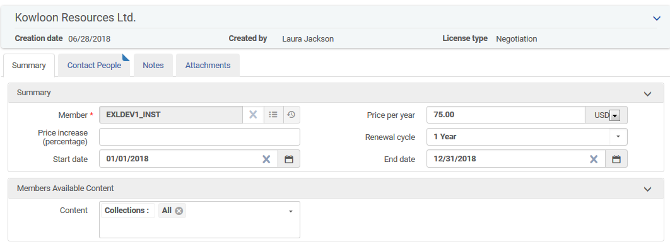
License members and negotiation details
Here we have added Alma University and stated that it will cost 75 USD.
For inventory we have chosen the two collections but not the portfolios

Slide 22
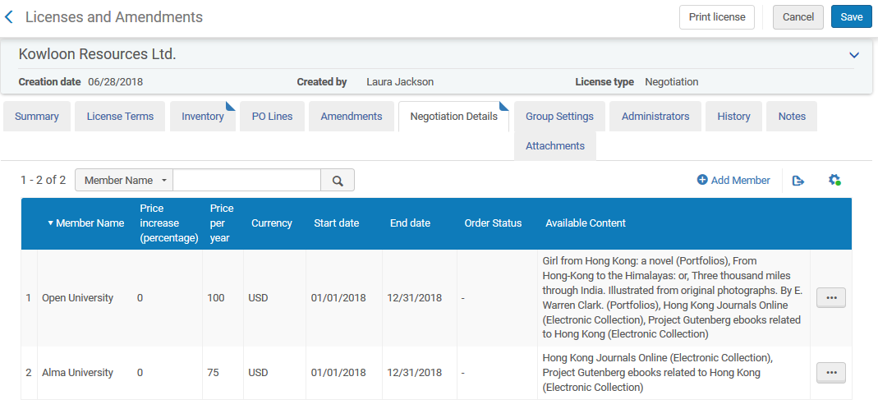
License members and negotiation details
Here is the summary. We can see the price details and inventory of the license for each member.
All four resources
The two collections

Slide 23
Introduction
Adding the Negotiation type license in Network Zone
Attributing inventory to the Negotiation type license
License members and negotiation details
Creating the order in the member institution
https://slidemodel.com/templates/animated-rainbow-business-powerpoint-template/
http://image.shutterstock.com/z/stock-photo-business-hand-writing-blank-agenda-list-130255148.jpg

Slide 24
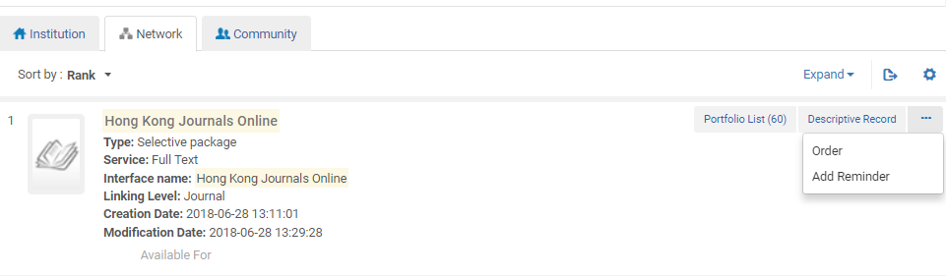
Creating the order in the member institution
If a staff member of Alma University searches the network for “Hong Kong Journals Online” then he can order it. This is a resource which was included in the negotiation details for Alma University.

Slide 25
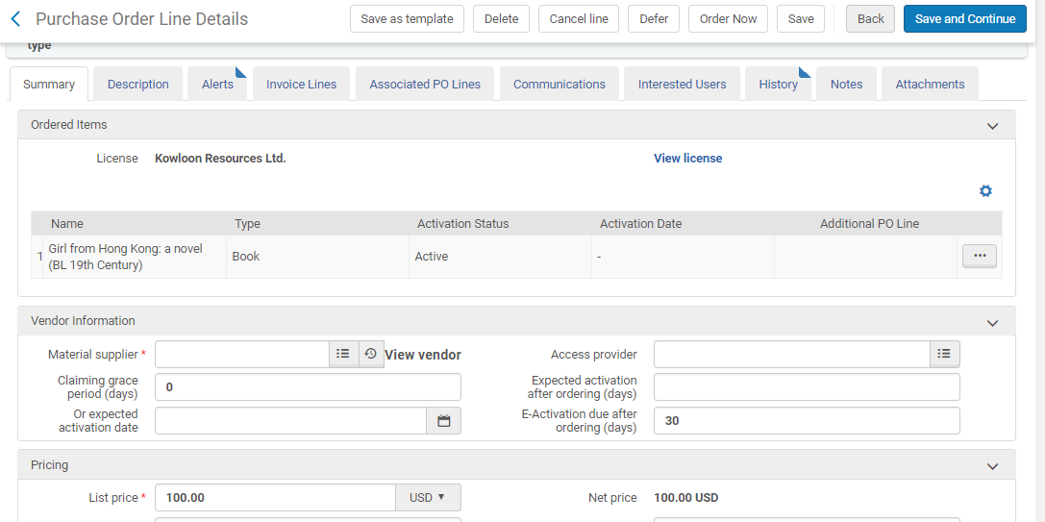
Creating the order in the member institution
When the order is created the license and the price is automatically filled in from the negotiation details of the license in the network zone

Slide 26
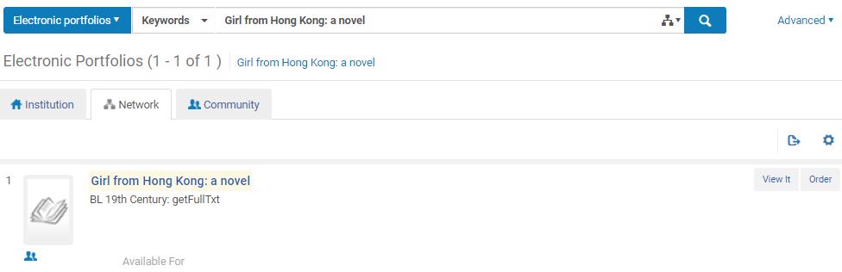
Creating the order in the member institution
If a staff member of Open University searches the network for “Girl from Hong Kong: a novel” then he can order it. This is a resource which was included in the negotiation details for Open University.

Slide 27
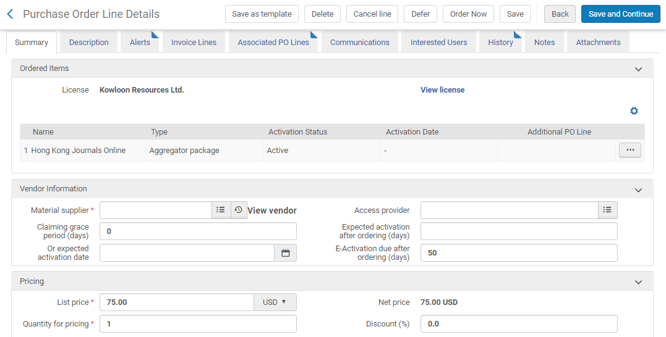
Creating the order in the member institution
When the order is created the license and the price is automatically filled in from the negotiation details of the license in the network zone

